Slide 1
OOP y C#
Scripting

Slide 2
Goals
Understanding the benefits of OOP.
Diagrams with UML.
Differences and similarities between C++ a C#
Practical exercises.

Slide 3
Programming paradigms
Problems often have multiple possible solutions.
Paradigms are approaches to how these problems are understood and solved.
Some languages ​​support multiple programming paradigms.
Paradigm | Programming languages support
Imperative | C, C++, Python, JavaScript
Functional | Haskell, Scala, Elixir, Lisp, C# (con LINQ)
Object Oriented Programming (OOP) | C++, C#, Java, Python,
Component Oriented Programming (COP) | Unity (C#), React (JavaScript).

Slide 4
Object Oriented Programming (OOP)
OOP uses the concept of "objects" as a foundation, which contain information in attributes, and code in the form of methods.
This encapsulation ensures that the only way an object can access data is through the methods of the object that contains the data.
The internal workings of an object can be modified without affecting the code that uses the object.
C++ and C# are OOP.

Slide 5
Key Concepts about OOP
Class:
A class is a template from which objects are created.
It defines the properties and behaviors that objects will have.
Classes do not take up memory space by themselves, they simply define the structure of future objects.
Objects:
An object is a concrete instance of a class.
Objects take shape at runtime when they are instantiated, taking up space in memory.
Each object can have different values ​​for its attributes.

Slide 6
Key Concepts about OOP
Attributes:
These are the properties or characteristics that define the state of an object. In a class, attributes are variables that store values. For example, in the Car class, an attribute could be color, brand, or speed. Attributes can be public, private, or protected depending on the visibility you want to give.
Methods:
Methods are the functions or actions that an object of the class can perform. In OOP terms, methods define the behavior of objects. For example, in the Car class, a method could be start() or brake(). Methods allow you to modify the attributes of the object or interact with other objects. They can also be public, private, or protected, depending on the access you want to provide.
Encapsulation:
This is the process by which the internal details of an object's operation are hidden and only the necessary parts are exposed through a public interface. This allows other parts of the system to interact with the object without knowing or depending on its internal implementation, thus reducing the coupling between different software components.

Slide 7
Key Concepts about OOP
Inheritance.
Mechanism that allows a class (subclass or derived class) to inherit attributes and methods from another class (superclass or base class). This encourages code reuse and the creation of hierarchies. For example, a Vehicle class can be the basis for classes such as Car and Truck.
Polymorphism.
The ability for different objects to be treated as instances of the same class through a common interface. Allows a method to behave differently depending on the object that invokes it. For example, a MakeSound method could produce different sounds depending on whether it is a dog or a cat.

Slide 8
OOP Advantages
Abstraction: Proximity of modeled concepts to real-world objects.
Separating behavior from implementation. The what and the how.
Encapsulation.
Facilitates code reuse. Thanks to inheritance and classes.
Maintainability: Changes in a class are automatically reflected in the objects that use it.
Modularity: Separation of concerns allows code to be divided into more manageable parts.

Slide 9
OOP Disadvantages
Non-linear data flow and execution may make it harder to follow.
Performance overhead: Creating objects and using methods may be less efficient in terms of pure performance than procedural programming.

Slide 10
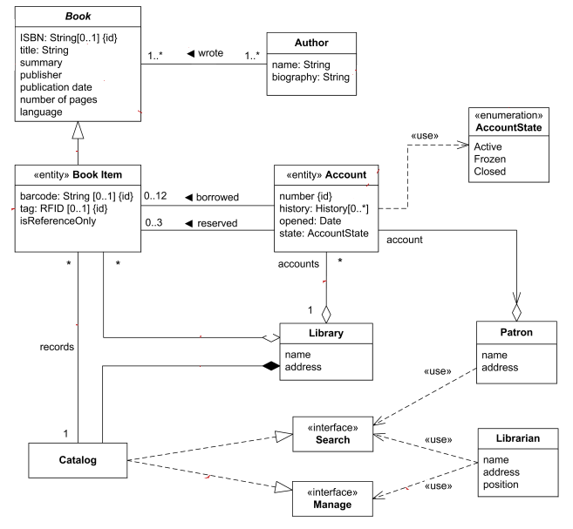
UML Diagram (Unified Modeling Language)

Slide 11
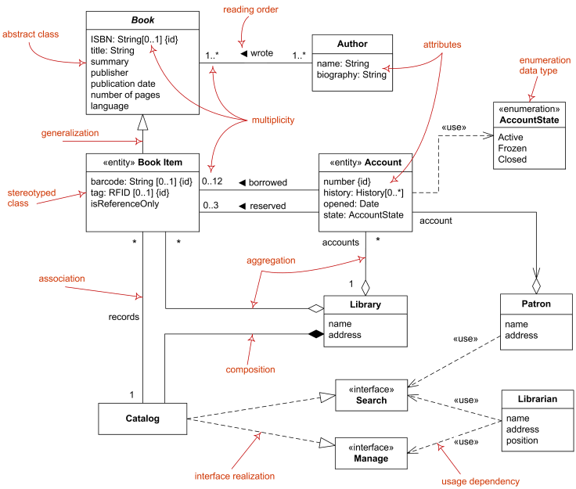
UML Diagram (Unified Modeling Language)

Slide 12
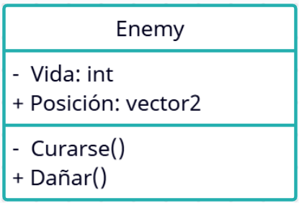
UML Diagram - Node
Object Name.
Attributes list.
Methods list.
Privacy level
+ | Public
- | Private
# | Protected
/ | Derived
~ | Package

Slide 13
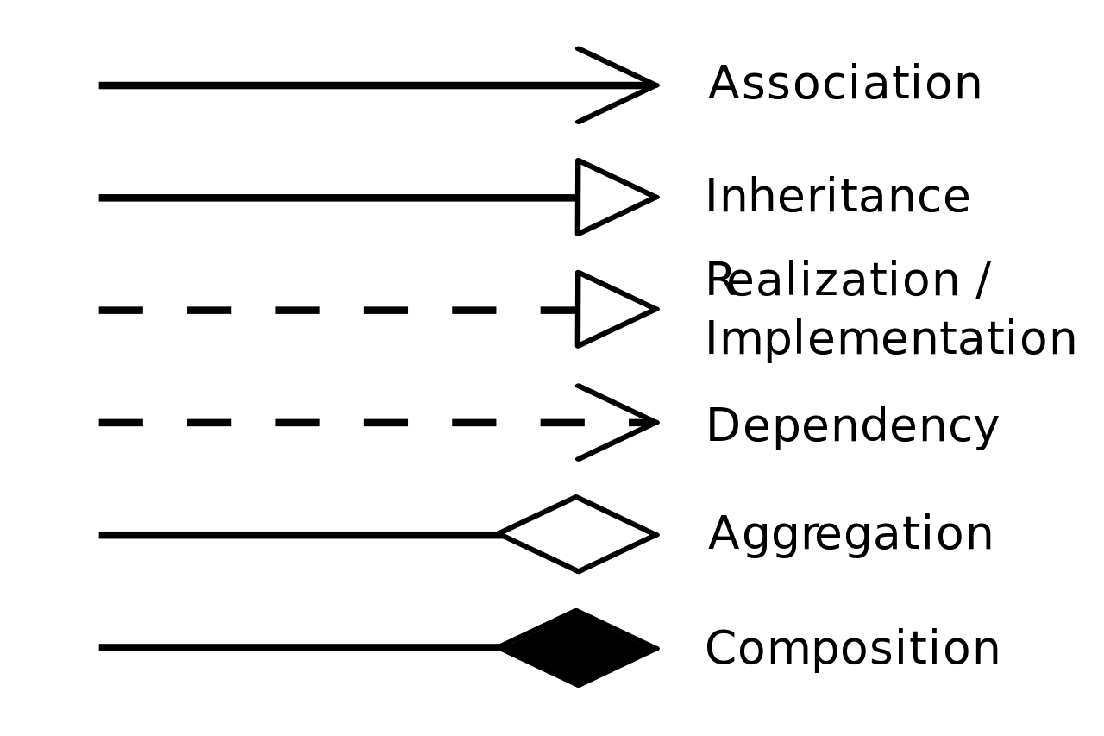
UML Diagram - Relations

Slide 14
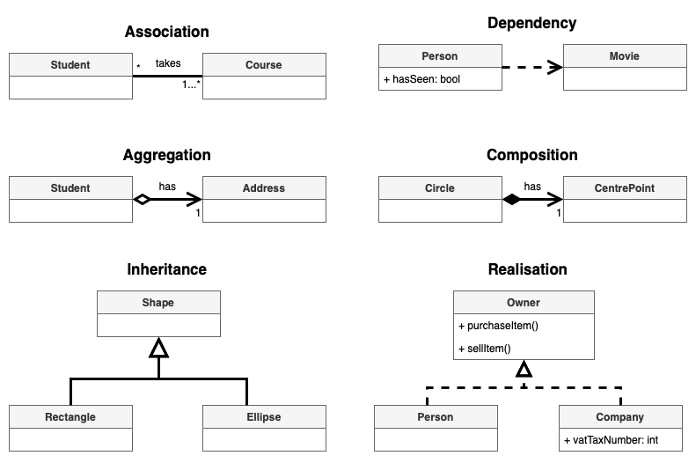
UML Diagram - Relations

Slide 15

UML Diagram - Relations: Association
Association: - Covers virtually any logical connection or relationship between classes.

Slide 16
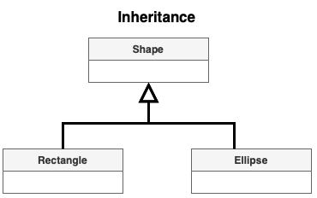
UML Diagram - Relations: Inheritance
Inheritance: - "Is a" hierarchical relationship between a superclass and subclass.

Slide 17

UML Diagram - Relations: Aggregation
Aggregation: - It is a stronger "whole-part" relationship but still not completely dependent.
In an Association, the Teacher and Students are simply connected in their day-to-day interaction, but they could cut off that relationship without consequences.
In an Aggregation, although the Wheels can exist without the Car, the Car needs them to be functional.

Slide 18

UML Diagram - Relations: Composition
Composition: - "Has a" (strong) relationship. One object depends on the other to exist.

Slide 19

C#
C# is a high-level, general-purpose programming language developed by Microsoft in 2000 as part of its .NET platform. It is a multi-paradigm language, meaning it supports several programming styles, including object-oriented, functional, and component-oriented. It was designed to be modern, simple, and flexible, with features such as automatic garbage collection, strong typing, and support for the Common Language Infrastructure (CLI), making it easy to port.
https://learn.microsoft.com/en-us/dotnet/csharp/

Slide 20
C# vs C++ : Similarities
The syntax and structuring of C# is very similar to that of C++ to facilitate migration between codes
OOP
C++ and C# are strongly typed languages
Members of a class are private by default

Slide 21
C# vs C++ : Differences
Compilation:
- C++: Generates machine code directly, allowing for greater control and performance optimization.
- C#: Generates intermediate code (IL, Intermediate Language) that is then compiled at runtime by the Common Language Runtime (CLR), which can impact performance compared to C++.
Efficiency:
- C++: Generally more efficient in terms of raw performance and memory usage, due to its proximity to the hardware and ability to optimize at the machine level.
- C#: Although less efficient in raw performance, its focus on safety and automatic memory management can lead to faster, less error-prone development.

Slide 22
C# vs C++ : Differences
Code separation:
- C++: Traditionally, code is separated into header files (.h) and implementation files (.cpp), allowing a clear distinction between the interface and the implementation.
- C#: There is no such separation. The class code, its declaration and definition are all contained in the same file.
Type inference:
- C++: Uses the auto keyword for type inference, allowing the compiler to deduce the type of the variable based on its initialization value.
- C#: Uses the var keyword for type inference, which works similarly to auto in C++.

Slide 23
C# vs C++ : Differences
Destructors:
- C++: Uses destructors, which are automatically invoked when an object goes out of scope, allowing the programmer to free resources and perform cleanup tasks manually.
- C#: Invoked when the garbage collector decides that an object is no longer needed, which may not be immediate. Due to automatic memory management, destructors are used less frequently.
Initialization:
- C++: Local variables and fields of a class or structure may contain garbage values ​​if not initialized explicitly.
- C#: Uninitialized local variables will give a compilation error.
Fields of a class or structure have default values.

Slide 24
C# vs C++ : Differences
Constants:
- C++: Both languages ​​use const to declare constants that cannot change their value after being initialized.
- C#: Additionally, it offers readonly, which allows a field to be assigned only at its declaration or within the class constructor. Once assigned, the value cannot be modified later.
Object instantiation:
- C++: It is not always necessary to use new to instantiate an object; it can be done on the stack without new.
- C#: It is necessary to use new to instantiate an object, which allocates memory on the heap and calls the class constructor.

